Slide 1
Introduction to map-reduce
Jiaul Paik
Email: jia.paik@gmail.com

Slide 2
Classical Data Processing
CPU
Memory
Single Node Machine
Data fits into memory
Load data from disk into memory and then process from memory
Data does not fit into memory
Load part of the data from disk into memory
Process the data
Disk

Slide 3
Motivation: Simple Example
10 Billion web pages
Average size of webpage: 20KB
Total 200 TB
Disk read bandwidth = 50MB/sec
Time to read = 4 million second = 46+ days
Longer, if you want to do useful analytics with the data

Slide 4

What is the Solution?
Use multiple interconnected machine as follows
BIG DATA
1. Split data into small chunks
2. Send different chunks to
different machines and process
3. Collect the results from
different machines
Known as Distributed Data processing in Cluster of Computers

Slide 5
How to Organize Cluster of Computers?

Slide 6
Cluster Architecture: Rack Servers
switch
Backbone switch
Typically 2-10 gbps
1 gbps between any pair of nodes
switch
switch
machine
machine
machine
machine
Rack 1
Rack 2
Each rack contains 16-64 commodity (low cost) computers (also called nodes)
In 2011, Google has roughly 1 million nodes

Slide 7
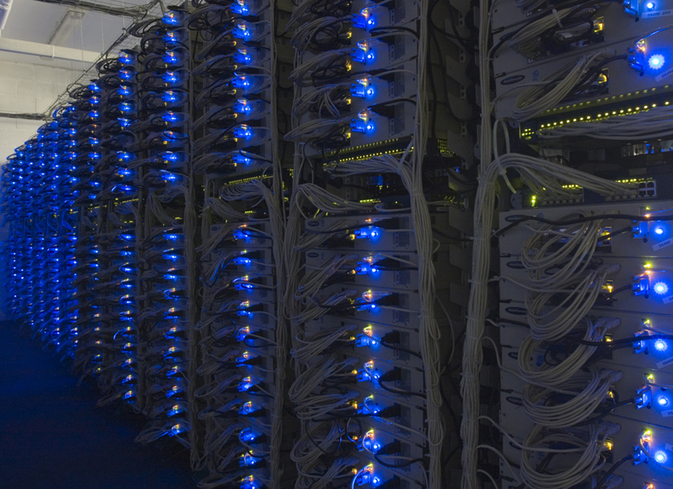
Google Data Centre

Slide 8
Challenges in Cluster Computing

Slide 9
Challenge # 1
Node failures
Single server lifetime: 1000 days
1000 servers in cluster => 1 failure/day
1M servers in clusters => 1000 failures/day
Consequences of node failure
Data loss
Node failure in the middle of long and expensive computation
Need to restart the computation from scratch

Slide 10
Challenge # 2
Network bottleneck
Computers in a cluster exchanges data through network
Example
Network bandwidth = 1 gbps
Moving 10TB of data takes 1 day

Slide 11
Challenge # 3
Distributed Programming is hard!
Why?
Data distributions across machines is non-trivial
(It is desirable that machines have roughly the same load)
Avoiding race conditions
Given two tasks T1 and T2,
Correctness of result depends on the sequence of execution of task
For example, T1 before T2 is must, but NOT T2 before T1

Slide 12
What is the Solution?
Map-Reduce
It is a simple programming model for processing really big data using cluster of computers

Slide 13

How Map-Reduce addresses the challenges?
Data loss prevention
By keeping multiple copies of data in different machines
Data movement minimization
By moving computation to the data
(send your computer program to machines containing data)
Simple programing model
Mainly using two functions
Map
Reduce
Programmer’s responsibility:
Write only two functions, Map and Reduce suitable for your problem
You DO NOT need to worry about other things

Slide 14
Redundant Storage Infrastructure
Distributed File System
Global file namespaces, redundancy
Multiple copies of data and in different nodes
Example: Google file system (GFS), HDFS (Hadoop, a open-source map-reduce system)
Typical usage pattern
Data is rarely updated in place
Reads and appends are common

Slide 15
Distributed File System: Inside Look
Data is kept in chunks, spread across machines
Each chunk is replicated on different machines
Ensures persistence
Example:
We have two files, A and B
3 computers
2 times replication of data
a1 a2 a3
b1 b2
A
B
Here are the Chunk Servers
a1
a2
b1
a1
a3
a3
b1
b2
a2
b2
Chunk servers also serve as compute nodes
Bring computation to the data

Slide 16
Distributes File System: Summary
Chunk servers
File is split into contiguous chunks (16-64 mb)
Each chunk is replicated (usually 2 times or 3 times)
Try to keep replicas in different racks
Master node
Stores metadata about where the files are stored
It might also be replicated

Slide 17
Map-Reduce Programming Model

Slide 18
Example Problem: Counting Words
We have a huge text document and count the number of times each distinct word appears in the file
Sample application
Analyze web server logs to find popular URLs
How you solve this using a single machine?

Slide 19
Word Count
Case 1: File too large for memory, but all <word, count> pairs fit in memory
You can create a big string array OR you can create a hash table
Case 2: All <word, count> pairs do not fit in memory, but fit into disk
A possible approach (write computer programs/functions for each step)
Break the text document into sequence of words
Sort the words
This will bring same words together
Count the frequencies in a single pass
Case 2 captures the essence of Map-Reduce
getWords(textFile)
sort
count

Slide 20
Map-Reduce: In a Nutshell
getWords(dataFile) sort count
Map
extract something you care about
(here word and count)
Group by key
sort and shuffle
Reduce
Aggregate, summarize, etc
Save the results
Summary
Outline stays the same
Map and Reduce to be defined to fit the problem

Slide 21
MapReduce: The Map Step
Input key-value pairs
(file name and its content)
Intermediate key-value pairs
(word and count)
k1
v1
map
f1
c1
k2
v2
map
f2
c2
k3
v3
…
…
map
k4
v4
f3
c3

Slide 22



MapReduce: The Reduce Step
Intermediate
key-value pairs
Output
key-value pairs
Key-value groups
k1
v1
reduce
k1
v1
v3
v6
k1
$$v′$$
k2
v2
Group
by key
reduce
k2
v2
v5
k2
$$v′′$$
k1
v3
…
k3
v4
…
…
k2
v5
k1
v6
k3
v4
reduce
k3
$$v′′′$$

Slide 23
Map-reduce: Word Count
Provided by the programmer
Provided by the programmer
MAP:
Read input and produces a set of key-value pairs
Group by key:
Collect all pairs with same key
Reduce:
Collect all values belonging to the key and output
(the, 1)
(crew, 1)
(of, 1)
(the, 1)
(space, 1)
(shuttle, 1)
(endeavor, 1)
(recently, 1)
(returned, 1)
(to, 1)
(earth, 1)
(as, 1)
(ambassadors, 1)
….
(crew, 1)
……..
(crew, 1)
(crew, 1)
(space, 1)
(the, 1)
(the, 1)
(the, 1)
(shuttle, 1)
(recently, 1)
…
(crew, 2)
(space, 1)
(the, 3)
(shuttle, 1)
(recently, 1)
…
The crew of the space shuttle Endeavor recently returned to Earth as ambassadors, harbingers of a new era of space exploration. Crew members at ……………………..
Big document
(key, value)
(key, value)
(key, value)

Slide 24
Word Count Using MapReduce: Pseudocode
map(key, value):
// key: document name; value: text of the document
for each word w in value
emit(w, 1)
reduce(key, values):
// key: a word; value: set of counts values for the word
result = 0
for each count v in values:
result += v
emit(key, result)

Slide 25
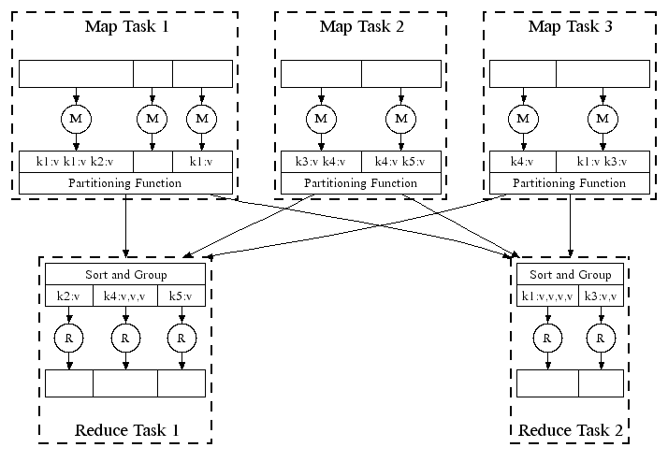
Map-reduce System: Under the Hood
Moving data across machines
All phases are distributed with many tasks doing the work in parallel

Slide 26
Map-Reduce Algorithm Design
Programmer’s responsibility is to design two functions:
Map
Reduce
A very important issue
Often network is the bottleneck
Your design should minimize data communications across machines

Slide 27
Problems Suitable for Map-reduce
Map-reduce is suitable for batch processing
Updates are made after whole batch of data is processed
The mappers do not need data from one another while they are running
Example
Word count
In general, map-reduce is suitable:
if the problem can be broken into independent sub-problems

Slide 28
Problems NOT Suitable for Map-reduce
In general, when the machines need to exchange data too often during computation
Examples
Applications that require very quick response time
In IR, indexing is okay, but query processing is not suitable for map-reduce
Machine learning algorithms that require frequent parameter update
Stochastic gradient descent

Slide 29
Exercises

Slide 30
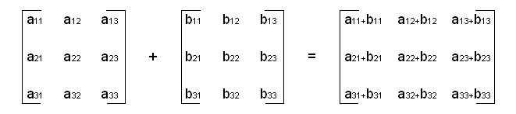
Warm-up Exercise
Matrix Addition
Can it be done in map-reduce?
YES
What is the map function (key and value)?
Key = row number; value = elements of row (as an array)
What is the reduce function?
For each key, reducer will have two arrays
Reduce function simply adds numbers, position-wise

Slide 31
Advanced Exercise: Join By Map-Reduce
Compute the natural join T1(A,B) ⋈ T2(B,C)
(combine rows from T1 and T2 such that rows have common value in column B)
T1
A | B
a₁ | b₁
a₂ | b₁
a₃ | b₂
a₄ | b₃
T2
B | C
b₂ | c₁
b₂ | c₂
b₃ | c₃
A | B | C
a₃ | b₂ | c₁
a₃ | b₂ | c₂
a₄ | b₃ | c₃
⋈
=

Slide 32
Map-Reduce Join
Map process
Each row (a,b) from T1 into key-value pair (b,(a,T1))
Each row (b,c) from T2 into (b,(c,T2))
Reduce process
Each reduce process matches all the pairs (b,(a,T1)) with all (b,(c,T2)) and outputs (a,b,c)

Slide 33
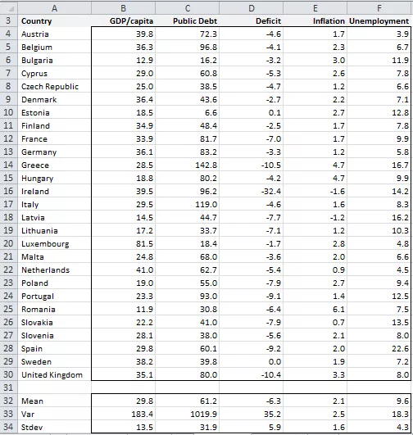
Advanced Exercise
You have a dataset with thousands of features. Find the most co-related features in that data.
features

Slide 34
Take Home Exercises
Design Map and Reduce functions for the following
Pagerank
HITS

